Slide 1

Understanding what is returned (5th class)
Presented by ARMS（THAILAND）Co., Ltd.

Slide 2
Index
Practical Web Development with Spring Boot
What is returned
Sample project
  1-1. Summary
  1-2. RequestParam
  1-3. Returning JSON
  1-4. PathVariable
  1-5. ModelAttribute

Slide 3
1. Sample Project
Practical Web Development with Spring Boot
What is returned
1-1. Summary
It is significantly important to understand what values are returned. whether it returns path, parameter, JSON, or View?

Slide 4
1. Sample project
Practical Web Development with Spring Boot
What is returned
1-2. RequestParam
Create a controller and run this project.
package com.arms;
import org.springframework.web.bind.annotation.RequestMapping;
import org.springframework.web.bind.annotation.RequestParam;
import org.springframework.web.bind.annotation.RestController;
@RestController
public class HelloController {
@RequestMapping("/list")
public String index(@RequestParam("name") String name){
return "Hello, " + name;
}
}
Access http://localhost:8080/list?name=John

Slide 5
1. Sample project
Practical Web Development with Spring Boot
What is returned
1-2. RequestParam
Change from @RestController to @Controller and run this project
package com.arms;
import org.springframework.web.bind.annotation.RequestMapping;
import org.springframework.web.bind.annotation.RequestParam;
import org.springframework.web.bind.annotation.RestController;
@Controller
public class HelloController {
@RequestMapping("/list")
public String index(@RequestParam("name") String name){
return "Hello, " + name;
}
}
Access http://localhost:8080/list?name=John
Error occurs….?

Slide 6
1. Sample project
Practical Web Development with Spring Boot
What is returned
1-2. RequestParam
@Controller returns the View while @RestController returns response contents. Add @ResponseBody annotation to return contents.
package com.arms;
import org.springframework.stereotype.Controller;
import org.springframework.web.bind.annotation.RequestMapping;
import org.springframework.web.bind.annotation.RequestParam;
import org.springframework.web.bind.annotation.ResponseBody;
@Controller
public class HelloController {
@RequestMapping("/list")
@ResponseBody
public String index(@RequestParam("name") String name){
return "Hello, " + name;
}
}
@Controller + @ResponseBody = @RestController???

Slide 7
1. Sample project
Practical Web Development with Spring Boot
What is returned
1-3. returning JSON
Create a Controller to return JSON
package com.arms;
import java.util.Collections;
import java.util.Map;
import org.springframework.stereotype.Controller;
import org.springframework.web.bind.annotation.RequestMapping;
import org.springframework.web.bind.annotation.ResponseBody;
@Controller
public class HelloJsonController {
@RequestMapping("/json")
@ResponseBody
public Map<String, String> index(){
return Collections.singletonMap("welcome", "Hello Springboot");
}
@RequestMapping("/")
public String getJn(){
return "index";
}
}
Access http://localhost:8080/json
You’ll see JSON format data

Slide 8
1. Sample project
Practical Web Development with Spring Boot
What is returned
1-3. returning JSON
Use JQuery ajax to receive JSON type data.
<!DOCTYPE html>
<html xmlns="http://www.w3.org/1999/xhtml"
xmlns:th="http://www.thymeleaf.org">
<head>
<meta http-equiv="Content-Type" content="text/html; charset=UTF-8">
<title>Ajax to receive JSON</title>
</head>
<body>
<div>
<span class="label">Welcome Message : </span>
<span class="value"></span>
</div>
</body>
<script src="https://code.jquery.com/jquery-1.12.1.min.js"></script>
<script type="text/javascript">
$(function() {
$.ajax({
url: '/json',
method: 'get',
cache: false
}).then(function(data) {
$('.value').text(data.welcome);
});
});
</script>
</html>
Ajax option parameter
url : the URL to which the request is sent
cache: set this to false to force the page not to cache by browser.
You’ll see “welcome” key to get “Hello Springboot” value
Access http://localhost:8080/

Slide 9
1. Sample project
Practical Web Development with Spring Boot
What is returned
1-4. PathVariable
Create a project and a controller as below to understand PathVariable
package com.arms;
import org.springframework.stereotype.Controller;
import org.springframework.web.bind.annotation.PathVariable;
import org.springframework.web.bind.annotation.RequestMapping;
import org.springframework.web.bind.annotation.ResponseBody;
@Controller
public class HelloController {
@RequestMapping("/list/{id}/{name}")
@ResponseBody
public String index(@PathVariable("id") int id, @PathVariable("name") String name){
return "UserName: " + name + " ID: " + id;
}
}
Access http://localhost:8080/list/7/Mike
And see PathVariable get URI values

Slide 10
1. Sample project
Practical Web Development with Spring Boot
What is returned
1-4. PathVariable
PathVariable is used to get RESTFUL URI
list/7
RequestParam is used to get a parameter as the name suggests.
list/?id=7
list/?name=John

Slide 11
1. Sample project
Practical Web Development with Spring Boot
What is returned
1-5. ModelAttribute
ModelAttribute is used when clients send data by x-www-form-urlencoded.
x-www-form-urlencoded is used when clients send form data to web server (Content-Type name)
x-www-form-urlencoded data pattern: id = data
If there are multiple form parameters, the following pattern is used
id=data1&form2=data2&form3=data3 (& is delimiter)
Data is URL encoded
_ . – are used as it is, space is +, other characters are %xx hex(16)

Slide 12
1. Sample project
Practical Web Development with Spring Boot
What is returned
1-5. ModelAttribute
Let’s see how @ModelAttribute works
package com.arms;
public class Greeting {
private int id;
private String content;
public int getId(){
return id;
}
public void setId(int id){
this.id = id;
}
public String getContent(){
return content;
}
public void setContent(String content){
this.content = content;
}
}
Create Greeting.java

Slide 13
1. Sample project
Practical Web Development with Spring Boot
What is returned
1-5. ModelAttribute
Let’s see how @ModelAttribute works
Create GreetingController.java
package com.arms;
import org.springframework.stereotype.Controller;
import org.springframework.ui.Model;
import org.springframework.web.bind.annotation.ModelAttribute;
import org.springframework.web.bind.annotation.RequestMapping;
import org.springframework.web.bind.annotation.RequestMethod;
@Controller
public class GreetingController {
@RequestMapping(value = "/greeting", method=RequestMethod.GET)
public String GreetingForm(Model model){
model.addAttribute("greeting", new Greeting());
return "greeting";
}
@RequestMapping(value = "/greeting", method=RequestMethod.POST)
public String greetingSubmit(@ModelAttribute Greeting greeting){
return "result";
}
}

Slide 14
1. Sample project
Practical Web Development with Spring Boot
What is returned
1-5. ModelAttribute
Let’s see how @ModelAttribute works
Create greeting.html
<!DOCTYPE HTML>
<html xmlns:th="http://www.thymeleaf.org">
<head>
<title>Form Input</title>
<meta http-equiv="Content-Type" content="text/html; charset=UTF-8" />
</head>
<body>
<h1>Greeting Form</h1>
<form action="#" th:action="@{/greeting}" th:object="${greeting}" method="post">
<p>Id: <input type="text" th:field="*{id}" /></p>
<p>Message: <input type="text" th:field="*{content}" /></p>
<p><input type="submit" value="Submit" /> <input type="reset" value="Reset" /></p>
</form>
</body>
</html>

Slide 15
1. Sample project
Practical Web Development with Spring Boot
What is returned
1-5. ModelAttribute
Let’s see how @ModelAttribute works
Create result.html
<!DOCTYPE HTML>
<html xmlns:th="http://www.thymeleaf.org">
<head>
<title>FormResult</title>
<meta http-equiv="Content-Type" content="text/html; charset=UTF-8" />
</head>
<body>
<h1>Result</h1>
<p th:text="'id: ' + ${greeting.id}" />
<p th:text="'content: ' + ${greeting.content}" />
<a href="/greeting">Submit another message</a>
</body>
</html>
After this, run your project and access
localhost:8080/greeting

Slide 16
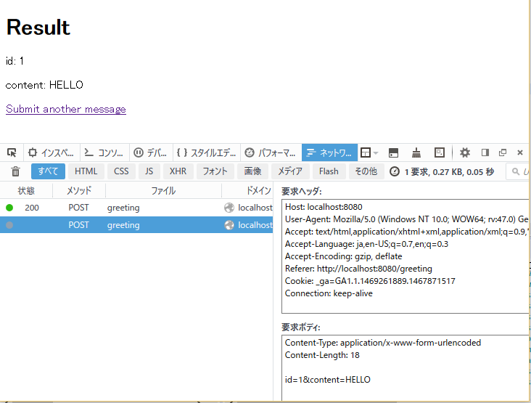
1. Sample project
Practical Web Development with Spring Boot
What is returned
1-5. ModelAttribute
Let’s try to submit form data and see what happens.
x-www-form-urlencoded
After this, run your project and access
localhost:8080/greeting
Id=1&content=HELLO

Slide 17
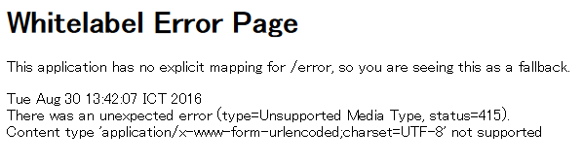
1. Sample project
Practical Web Development with Spring Boot
What is returned
1-5. ModelAttribute
What if you change @ModelAttribute to @RequestBody.
GreetingController.java
@RequestMapping(value = "/greeting", method=RequestMethod.POST)
public String greetingSubmit(@RequestBody Greeting greeting){
return "result";
}
}
x-www-form-urlencoded can not receive

Slide 18

Your Idea Leads Your Ideals
homepage: http://arms-asia.com/
facebook: https://www.facebook.com/arms.asia?fref=ts

